Slide 1
Chapter Four
Literature Review

Slide 2
Lessons
Meaning of Literature Review
Purpose of Literature Review
The Literature Review Process
Citation, Referencing and Plagiarism
Components of a Research Proposal

Slide 3
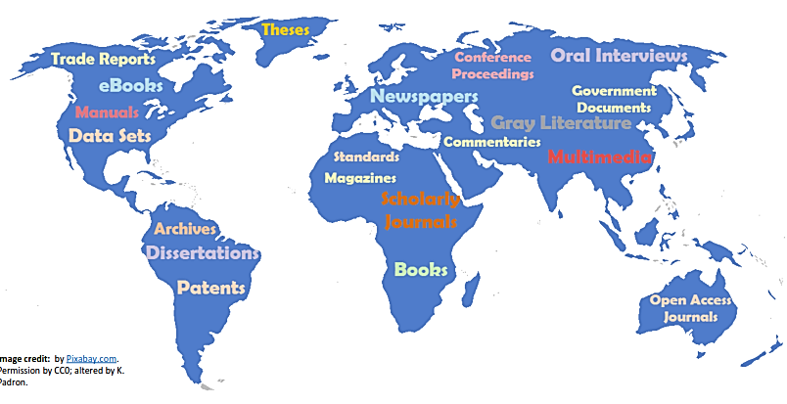
Review of Literature
The phrase ‘Review of Literature’ consists of two words: Review and Literature
In research methodology the term “literature” refers to the knowledge of a particular area of investigation of any discipline which includes theoretical, practical and its research studies
What Is The Literature?

Slide 4
Review of Literature
The term ‘Review’ means to organize the knowledge of the specific area of research to evolve an organization of knowledge to show that this study would be an addition to this field
What Is Literature Review?
The process of identifying, locating, examining, and synthesizing scholarly information and publications on a particular topic.
One of the first things done by any student or scholar who plans to pursue new knowledge or do research in most subject areas
The literature review establishes the base upon which any new work stands

Slide 5
Review of Literature
A literature review essentially consists of critically reading, evaluating and organizing existing literature on the topic to assess the state of knowledge in the area
During this stage you should aim to become an ‘expert’ in your field of research
Functions of review literatures are:
  Bring clarity and focus to your research problem
  Improve your methodology
  Broaden your knowledge
  Contextualize your findings
Literature review is integral part of the entire research process and makes valuable contribution to every operational step

Slide 6
Purpose of Literature Review
It provides theories, ideas, explanations or hypothesis which may prove useful in the formulation of a new problem
It indicates whether the evidence already available solves the problem adequately without requiring further investigation
  It avoids the replication
It suggests method, procedure, sources of data and statistical techniques appropriate to the solution of the problem.
It locates comparative data and findings useful in the interpretation and discussion of results

Slide 7
Purpose of Literature Review
To find out what other scholars are writing about your topic
To learn methods and approaches that are appropriate for your study
To learn appropriate theory to underpin your work
To help focus your research and sharpen and refine your research questions
To avoid reinventing the wheel, to demonstrate to your audience that your contribution is new – different from everyone else’s
  Nobody will believe you unless you can demonstrate through the literature review that you know what everyone else has done

Slide 8
Procedures for Reviewing the Literature
Search for existing literature in your area of study
  Internet, books, journals and articles
Review the selected literatures
  Start reading them critically to pull together themes and issues that are associated with your study
Develop a theoretical framework
  Your theoretical framework refers to the underlying theoretical approach that you adopt to underpin your study
Develop a conceptual framework
  The conceptual framework defines and organises the concepts important within your study

Slide 9
Crediting Sources
Crediting sources gives an author or resource credit for original information.
Crediting sources in your paper includes two parts:
In-Text Citations: When you present information in the body of your paper, you briefly identify its source
Reference List: On a separate page at the end of your paper, you write a detailed list of the sources cited in your paper
The in-text citations and reference list should credit the exact same sources

Slide 10
What is Reference or Citation?
A reference is the detailed bibliographic description of the item from which you gained your information
It clearly identifies the source in which the full-text of the item is to be found
Referencing is the standardized method of acknowledging sources of information and ideas that are used in an assignment in a way that uniquely identifies its source
Citation is an abbreviated form to reference contents from another author in order to correspond to a bibliographic reference

Slide 11
Why Referencing ?
References are used to:
Enable the reader to locate the sources you have used
Help support your arguments and provide your work with credibility
Show the scope of your research
Acknowledge the source of an argument or idea
Avoid Plagiarism

Slide 12
Why Referencing ?
What is Plagiarism?
Plagiarism is defined as presenting someone else’s work as your own by:
  Cutting and pasting from other sources
  Quoting without “…” or a citation
  Paraphrasing or summarizing without a citation
  Using images, tables or graphs without a citation
  Re-using own work which was previously marked
  Forgetting to cite is still plagiarism

Slide 13
What Should You Credit?
Any information that you learned from another source including facts, statistics, opinions, theories, photographs, and charts
Credit these sources when you mention their information in any way (quotations, summaries, paraphrases)
EXCEPTIONs: Information that is common knowledge
    Barack Obama is the president of the United States
    The declaration of independence was signed July 4, 1776.

Slide 14
Types of Referencing
Direct Quotation
  To reproduce part of the original text exactly, word for word.
  Placed in “…”
  Do not overuse them.
  Squared brackets for changes made (usually for clarity)
  Example:
Einstein once said, “If you can’t explain [an idea] to a six year old, you can’t understand it yourself”.

Slide 15
Types of Referencing
Paraphrasing
  Re-writing another person’s ideas using your own words
  Demonstrates your understanding of what you have read
  Do not change the meaning or drop important ideas
  Example:
According to Einstein, to have a good grasp of a certain scientific concept is to be able to explain the concept to a curious child

Slide 16
Types of Referencing
Summarizing
  A more concise/compact form of paraphrasing
  Use only the most important or relevant information
  Follow the same order of ideas
  Example:
To test your understanding, try explaining it to a friend.

Slide 17
Criteria for Choosing to Reference
Relevance:
  To what extent is this source relevant?
  Is the information provided a partial or restricted view of the subject?
  Are counter arguments presented and treated with respect?
Currency:
  When was the source published?
  Are there revised editions?
Authority:
  Is the source authoritative/credible?
  Do other authors refer this source?
Scope:
  How general or particular are the ideas/models/practices described (limited in time/space/population)?

Slide 18
IEEE Referencing Style
Institute of Electrical and Electronics Engineers (IEEE)
In IEEE citations the references should be numbered and appear in the order they appear in the text
In-Text Citation Format
When referring to a reference in the text of the document, put the number of the reference in square brackets.
Examples: [3].
[3],[5].
[3], [4], [5].
[3-5].
Example:
A similar study conducted by [1] revealed the level of Internet awareness was quite high with respondents.

Slide 19
In-Text Citation Example
[1] has provided evidence that these figures are incorrect.
There is some evidence [1] that these figures are incorrect. However, [2] suggests an alternative theory. But on reflection the original evidence [1] has the advantage of a large study.
…this has been discovered in a number of recent studies [3], [10], [14].

Slide 20
Reference List
The IEEE citation style has 3 main features:
  The author name is first name (or initial) and last.
  The title of an article (or chapter, conference paper, patent etc.) is in quotation marks.
  The title of the journal or book is in italics.
Book (IEEE) - [Citation Numbers] Author's Name, Title of book, edition, editors, translators. Location: Publisher, year of publication, page number(s).
[1] N.B. Sterne, Computing in the information age, 2nd ed. New York: Wiley, 1996, pp. 120-25.
[2] M. Ashby, H. Shercliff and D. Cebon, Materials: engineering, science, processing and design, 2nd ed. Oxford: Butterworth-Heinemann, 2010.

Slide 21
Reference List
Book Chapters
Author(s). “Chapter title” in Book title, edition, volume. Editors name, Ed. Publishing location: Publishing company, year, pp.
[3] J.E. Bourne. “Synthetic structure of industrial plastics,” in Plastics, 2nd ed., vol. 3. J. Peters, Ed. New York: McGraw-Hill, 1964, pp.15-67.
Article in a Journal
Author(s). “Article title”. Journal title, vol., pp, date.
[4] G. Pevere. “Infrared Nation.” The International Journal of Infrared Design, vol. 33, pp. 56-99, Jan. 1979.
Articles from Conference Proceedings (published)
Author(s). “Article title.” Conference proceedings, year, pp.
[5] D.B. Payne and H.G. Gunhold. “Digital sundials and broadband technology,” in Proc. IOOC-ECOC, 1986, pp. 557-998.
Standards/Patents
Author(s)/Inventor(s). “Name/Title.” Country where patent is registered. Patent number, date.
[6] E.E. Rebecca. “Alternating current fed power supply.” U.S. Patent. 7 897 777, Nov. 3, 1987.

Slide 22
Reference List
Electronic References
Books
Author. (year, Month day). Book title. (edition). [Type of medium]. Vol. (issue). Available: site/path/file [date accessed].
[8] S. Calmer. (1999, June 1). Engineering and Art. (2nd edition). [On-line]. 27(3). Available: www.enggart.com/examples/students.html [May 21, 2003].
Journal
Author. (year, month). “Article title.” Journal title. [Type of medium]. Vol. (issue), pages. Available: site/path/file [date accessed].
[9] A. Paul. (1987, Oct.). “Electrical properties of flying machines.” Flying Machines. [On-line]. 38(1), pp. 778-998. Available: www.flyingmachjourn/properties/fly.edu [Dec. 1, 2003].
World Wide Web
Author(s)*. “Title.” Internet: complete URL, date updated* [date accessed].
[10] M. Duncan. “Engineering Concepts on Ice. Internet: www.iceengg.edu/staff.html, Oct. 25, 2000 [Nov. 29, 2003].

Slide 23
Other Reference Styles
There are so many different styles are available for referencing information materials.
But, the following are the most common
Different professions use different styles
Types of citation style that the researchers used in their study:
APA (American Psychological Association) style
  Social Sciences (Psychology, Sociology, Communications, etc.)
  Nursing
  “ Author, date” system
Chicago Style
  History
  Arts
  Sciences

Slide 24
Research Report Writing

Slide 25
Outline of a Research Report
The following are suggested outlines of chapters and sections in your report:
Preliminary Pages
Title page
Acknowledgment
Abstract
Table of Content
List of Tables
List of Figures
List of Acronyms
Declarations

Slide 26
Outline of a Research Report
Chapter One: Introduction
Background
Statement of the Problem
Research Questions
Objective of the Study
Scope of the Study
Limitation of the Study
Significance of the Study
Operational Definition of Terms
Organization of the report

Slide 27
Outline of a Research Report
Chapter Two: Literature Review
Literature Review
Related Works

Slide 28
Outline of a Research Report
Chapter Three: Research Methodology
Study Area
Research Approach
Research Design
Study Population and Sampling
Data Collection Methods and Procedures
Validity and Reliability of Data Collection Instruments
Data Analysis
Ethical Considerations

Slide 29
Outline of a Research Report
Chapter Four: Results and Discussions
Results and Findings
Discussion of Results

Slide 30
Outline of a Research Report
Chapter Five: Conclusions and Recommendations
Conclusions
Recommendations
References
Appendixes

Slide 31
Chapter Five
Measurement and Descriptive Statistics

Slide 32
Measurement and descriptive statistics
Levels of measurement
Measures of central tendency and dispersion
Sampling theory and practice

Slide 33
MEASUREMENT AND DESCRIPTIVE STATISTICS
A statistics is a numerical representation of information/data sets. It could be:-
  Descriptive statistics or
  Inferential statistics.
Descriptive statistics are used to organize or summarize based on a collected data.
Inferential statistics use to infer based on the sample data of the larger population.

Slide 34
LEVELS/ SCALES OF MEASUREMENT
A research measurement has a broader meaning than usual such as length, weight, height etc. it is done using statistical analyses.
Scales /level of measurement:-is the ways to defined and categorized different data:-numbers or variables
level of measurement uses to interpret easily the data from sets of variables.
There are four types of scales of measurement:-
      Nominal
      Ordinal
      Interval and
      Ratio

Slide 35
Nominal:-
Classifies individuals, companies, products, brands or other entities into categories where no order is implied. Label, Categorical.
  Example; What is your gender? Male, Female
  Refers to list of choice.(married,” “single,” “divorced,” )
Ordinal:-
Ordinal scales involve the ranking of individuals, attitudes or items.
Described as first, second, third place etc.
Interval:
  Used to represent quantities which have equal units.

Slide 36
  For this type of scale, zero takes an additional point.
  Which means, zero does not represent the absolute lowest value because there are numbers which could be above and below it like Fahrenheit scale described as -3 up to 3 ºf.
Ratio:-
  It is similar to the interval scale in that it also represents quantity and has equality of units.
  But, this scale also has an absolute zero (no numbers exist below zero).
  For example the ratio data of height and weight could not be below zero unit

Slide 37
CONT…
Class activity
1.where are you born? which scale of measurement is it?
2. A teacher rank students according to their result, which scale of measurement is it?
3. Multiple choice achievement tests are usually assumed to measure at what level?

Slide 38
Data can be measured with different measures:
Measures of Central Tendency (Measures of Location)
  Mode
  Median
  Mean
Measures of Variability
  Range
  Variance
  Standard Deviation
Measures related to the form of the distribution
  Skewness
  Kurtosis

Slide 39
MEASURES OF CENTRAL TENDENCY
It refers to the idea that there is one central number that best summarizes the entire set of measurements.
Mode:-
  The greatest frequency from the given set of measurements.
Median:-
  The median is the number at which half the measurements are more than that number and half are less than that number.
  It is measured after the data sets are sorted. Thus (about) 50 % of observations are smaller and (about) 50 % are larger than the median.
  It can be calculated as (n+1)^{th}/2 whenever our set of data has odd numbers. If we have even numbers of measurements, the media is calculated as ((n/2)^{th} + ((n/2)+1)^{th} )/2

Slide 40

Mean:-
  It is the average of the given data sets.
  It is the sum of all our measurements, divided by the number of measurements.
  Calculate the expected value whether the distribution of measurements were random or sorted
  The mean can be calculated as follow:

Slide 41
MEASURES OF VARIABILITY:-
Also called statistical dispersion
It is the "spread out" of all the measurements from central number. Some of measure of variance are:-
Range:-
  The range is the difference from the smallest measurement to the largest value
  Calculated as Max-Min
  Used for quantitative data

Slide 42
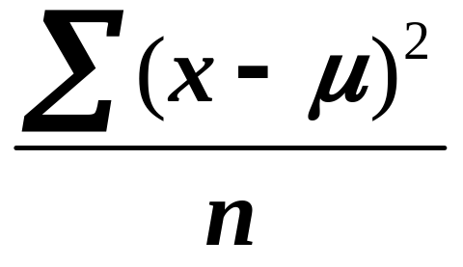
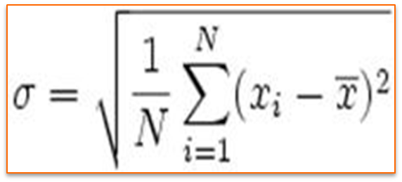

Variances and Standard deviation:-
  The standard deviation is the square root of the variance of the measurement.
  The standard deviation could obtained as:-
Mean is represented by and n is the number of items.

Slide 43
let’s calculate the variance of the follow data set: 2, 7, 3, 12, 9.
The first step is to calculate the mean. The sum is 33 and there are 5 data points.
Therefore, the mean is 33 ÷ 5 = 6.6. Then you take each value in data set, subtract the mean and square the difference. For instance, for the first value:
(2 - 6.6)² = 21.16
The squared differences for all values are added:
21.16 + 0.16 + 12.96 + 29.16 + 5.76 = 69.20
The sum is then divided by the number of data points:
69.20 ÷5 = 13.84
The variance is 13.84. To get the standard deviation, you calculate the square root of the variance, which is 3.72.

Slide 44
SAMPLING THEORY AND PRACTICE
Basic Concepts of population and sampling
  The Population consist of the set of all measurements in which the investigator is interested.
  A population is a complete set of units with a specified set of characteristics at which a sample could be selected.
  A population is the group to which a researcher would like the results of a study to be generalized.
Sample
Subset of population

Slide 45
Advantages of census
    Reliability: Data derived through census are highly reliable. The only possible errors can be due to computation
    Detailed information: Census data yield much more information.
Limitation of census
    Expensiveness:- Investigating population is expensive to any individual researcher
    Excessive time and energy: census survey takes too long time and consumes too much energy.
Sampling:-
  A Sample is a subset of measurements selected from the population. It is a scientist’s way of collecting information, and undertaken to answer specific question.

Slide 46
  Sampling is a process of extracting a small portion from a large quantity of material.
  The sample what the researcher collected should represents the original object.
  Therefore, sampling is the process of using a small number or part of a larger population to make conclusion about the whole population.

Slide 47
Characteristics of Good Sample
  Represent the target population so as to minimize bias (or systematic error)
  Large enough to minimize random variation differences that might occur between the sample and target populations
  Therefore, sampling is done due to the following main reasons:-
    Economy,
    Timeliness,
    The large size of many populations,
    Inaccessibility of some of the population,
    Accuracy etc

Slide 48
Limitations of sampling technique
Less accuracy: In comparison to census technique the conclusion derived from sample are more liable to error.
Misleading conclusion: If the sample is not selected carefully or arbitrarily, the conclusion derived from them will become misleading to conclusions.
Need for specialized knowledge: The sample technique can be successful only if a competent and able scientist makes the selection.

Slide 49
Sampling technique is used under the following conditions.
Vast data: due to economize money, time and effort
When at most accuracy is not required: it is very suitable when 100% accuracy is not required.
Infinite population: If the population is unlimited
When census is impossible: for example to know the amount of mineral wealth in a country we cannot dig all mines. So, we use sampling technique.
Homogeneity: If all units of the population are alike (similar) sampling technique is easy to use.

Slide 50
SAMPLING ERROR AND NON SAMPLING ERROR
Sampling Error:- is the difference between the result of a sample and the result of census. It is the difference between the sample estimation and the actual value of the population.
Systematic Error (non-sampling error)/sampling bias:-
    Such error can be created from errors in the sampling procedure, and it cannot be reduced or eliminate by increasing the sample size.
    It is occurred because of human mistakes and not chance variation.
    For example inappropriate sampling frame, accessibility bias, defective measuring device, and non-response bias or defects in data collection.

Slide 51
Sampling Methods classification summary
Sampling
Methods
Probability
Samples
Non-
probability
Systematic
Stratified
Convenience
Snowball
Simple
Random
Cluster
Judgment
Quota

Slide 52
Probability Sampling or Representative sampling:
  Probability sampling involves random selection
  Each unite of the population will be represented in the sample.
  With a probabilistic sample, we know the probability that we have represented the population well. The error could be measured.
It is of four types:
Systematic sampling
Stratified sampling
Simple random sampling
Cluster sampling

Slide 53
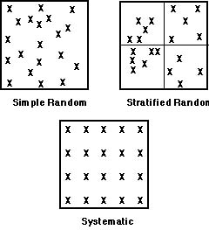
Sampling

Slide 54
I. Simple random sampling:-
Defined population have an equal and independent chance of being selected.
Selected with equal chance of selection .
Steps
Identify and define the population,
Determine the desired sample size,
List all members of the population,
Assign all individuals on the list a consecutive numbers from 1 to the last individual,
Finally use lottery method.

Slide 55
CONT…
II. Systematic sampling: the process of selecting individuals within the defined population from a list by taking every Kth element.
Steps
Identify and define the population,
Determine the desired sample size,
Determine Kth element(kth element=pop/sample size),
Obtain a list of the population,
Use lottery method until you get the first element from the population.
Example: no of pop=600
sample size=60
Kth element=600/60=10

Slide 56
CONT…
III. Stratified sampling: The population is divided into two or more groups called strata, according to some criterion, such as geographic location, grade level, age, or income, and subsamples are randomly selected from each strata.
steps
Identify and define the population.
Determine the desired sample size.
Identify the variable and subgroups (strata) for which you want to guarantee appropriate, equal representation.
Randomly select, “appropriate” number of individuals from each of the subgroups/strata.

Slide 57
CONT…
Iv. Cluster sampling
Divide population into groups (clusters), take a random sample of clusters and measure only the selected clusters.
The primary sampling unit is not the individual element, but a large cluster of elements.
Radom will be made at cluster as well at the individual level.
Geographical area act as criteria.
Example: Sample students at university.
A university has 6 college, each college has 10 dept. total 60 clusters. Take sample randomly from 60 cluster.
and measure everyone on those clusters.
NB: In stratified sampling, a random sample is drawn from each of the strata, whereas in cluster sampling only the selected clusters are studied.

Slide 58
2. Non Probability Sampling
  Non-probability sampling does not involve random selection,
  Some members of the population have little or no chance of being selected
  With non-probability sampling, we do not know if we have represented the population well.
  Four types:-
Convenience sampling
Snowball sampling
Judgment sampling
Quota sampling

Slide 59
A. Convenience Sample
  The sampling procedure used to obtain those units or people most conveniently available.
  Sample being drawn from population which is close to hand.
Advantages
  Very low cost
  Extensively used/understood
  No need for list of population elements
Disadvantages
  Variability and bias cannot be measured or controlled
  Projecting data beyond sample not justified.

Slide 60
B. Snowball sampling
  The sampling procedure in which the initial respondents are chosen by probability or non-probability methods, and then additional respondents are obtained by information provided by the initial respondents.
  It is a method in which a researcher identifies one member of some population of interest.
  It is very good for cases where members of a special population are difficult to locate.

Slide 61
C. Judgment, Purposive or Selective Sample
  It is a sampling method in which elements are chosen based on purpose of the study from available information.
  It may involve studying the entire population of some limited group or a subset of a population.
  It is opposite of random sampling.
Advantages
  Moderate cost
  Commonly used/understood
  Sample will meet a specific objective
Disadvantages
  Bias!
  Projecting data beyond sample not justified.

Slide 62
D. Quota Sample
  The sampling procedure that ensure that a certain characteristic of a population sample will be represented to the exact extent that the investigator desires.
  The population is first segmented into mutually exclusive sub-groups, just as in stratified sampling. Then judgment is used to select the subjects or units from each segment based on a specified proportion.
  In quota sampling the selection of the sample is non-random.
  As with stratified samples, the population is broken down into different categories. However, the size of the sample of each category does not reflect the population as a whole.

Slide 63
Chapter Six
Survey and experimental research

Slide 64
  Introduction to Survey Research
A survey is defined as a brief interview or discussion with individuals about a specific topic.
Survey research involved by the use of questionnaires and/or statistical surveys to gather data.
It tends to be quantitative in nature and aims to collect information from a sample of the population.
They are particularly useful for non experimental descriptive designs that seek to describe reality.

Slide 65
Therefore, there are two key features of survey research:
Questionnaires: a predefined series of questions used to collect information from individuals
Sampling: a technique in which a subgroup of the population is selected to answer the survey questions; the information collected can be generalized to the entire population of interest

Slide 66
MODES OF SURVEY ADMINISTRATION
Face to face interviews/personal interview
Telephone interviews
Mailed questionnaires.

Slide 67
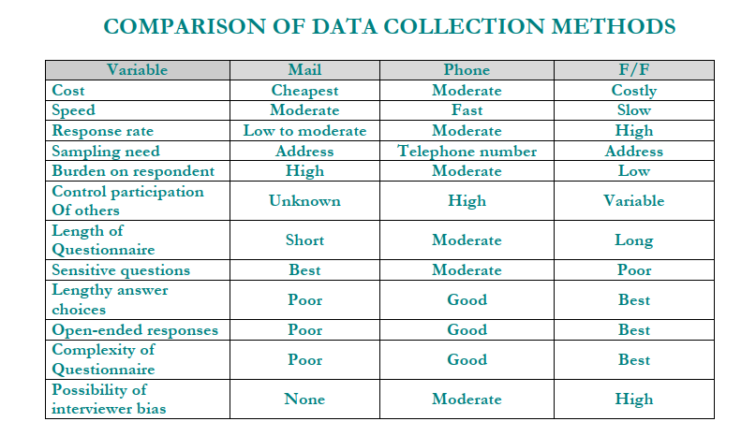

Slide 68
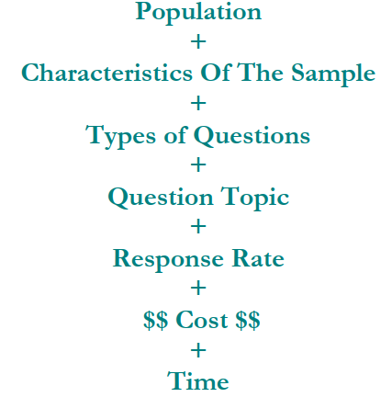
HOW DO YOU DECIDE ON THE MODE OF DATA COLLECTION?

Slide 69
Advantages of survey research
It is possible to accomplished several data using structured questions within short time.
Can be completed by telephone, mail, fax, or in-person.
With the appropriate sample, it is possible to generalizable to an entire population.
Standardized, structured questionnaire minimizes interviewer bias.
Tremendous volume of information can be collected in short period of time.
Can take less time to analyze than qualitative data.
Sample surveys are a cost-effective and efficient means of gathering information about a population
Survey sampling makes it possible to accurately estimate without interviewing all members of the population

Slide 70
DISADVANTAGES OF SURVEYS
Can be very expensive.
Requires some statistical knowledge:- sampling, specialized skills to process, interpret results
Respondents often will not share sensitive information in the survey format
A growing problem in survey research is the widespread decline in response rates.

Slide 71
What are the types of survey designs?
Based on time of data collection
1. Cross-sectional Surveys
2. Longitudinal Surveys
A cross-sectional study collects data from a group of people at a single point in time, while a longitudinal study collects data from the same group of people over time.
cohort surveys - which follow the same group of individuals over time,
trend surveys - which take repeated samples of different people each time but always use the same core questions.
A cohort study is more difficult to carry out than a trend survey because the same individuals have to be traced over time and inevitably some participants move house, some fall ill and die, and some just refuse to participate.

Slide 72
A fine example of a cohort study is the National Child Development Study, which is based on an initial sample of children born in one week in 1947 and continued to follow them through over many years.
A particularly well known version of a trend survey is the General Household Survey which is carried out on an annual basis.

Slide 73
What are key characteristics of survey research?
Sampling from a population
Collecting data through questionnaires or interviews
Designing instruments for data collection
Obtaining a high response rate

Slide 74
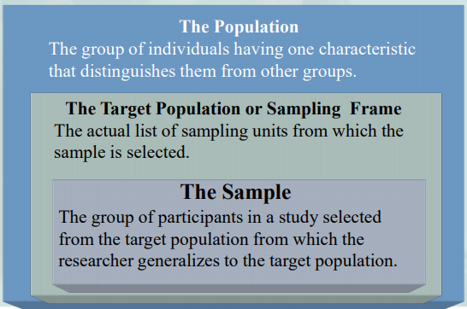
Population, Target Population or Sampling Frame, Sample

Slide 75
Reducing error in survey research
Reducing Coverage Error: have a good sampling frame list on which to select individuals
Reducing Sampling Error: select as large a sample from the population as possible
Reducing Measurement Error: use a good instrument with clear, unambiguous questions and response options
Reducing non-response error: use rigorous administration procedures to achieve as large a return rate as possible

Slide 76
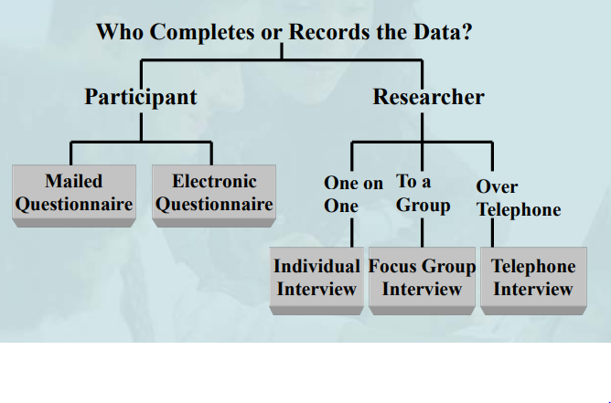
Forms of data collection based on who completes or records the data

Slide 77
Question construction problems
Question is unclear
Multiple questions
Question is wordy
Question is negatively worded
Unbalanced response options
Mismatch between questions and answers
Question includes overly technical language
Not all questions are applicable to all the participants

Slide 78
Steps in conducting survey research
• Decide if a survey is the best design to use
• Identify the research questions or hypotheses
• Identify the population, the sampling frame and the sample
• Determine the survey design and data collection procedures
• Develop or locate an instrument
• Administer the instrument
• Analyze the data to address the research questions or hypotheses
• Write the report

Slide 79
Evaluating survey research
Was the target population or sampling frame clearly specified?
Was the sampling procedure specified? If a random sample was not used, were modifications from it explained?
Was the sample clearly identified and the basis on which it was chosen specified?
Did the type of survey match the questions or hypotheses advanced by the author?

Slide 80
Evaluating survey research
Was information reported on reliability and validity of scores from past use of the questionnaire or interview?
Did the author mention the dates on which the questionnaire or interview was administered?
Were the administration procedures clearly identified?
Did the data analysis match the research questions or hypothesis to be answered in the study?

Slide 81
Evaluating survey research
If an interview was used, were the field procedures for collecting this information specified? Were demographic characteristics, previous experience, training, and monitoring discussed for the interviewer(s)?
Did the researcher check on the reliability and validity of scores from the data collection in the study?
Was the study written scientifically and ethically?

Slide 82
EXPERIMENTAL RESEARCH
Experimental research is conducted mostly in laboratories in the context of basic research.
The principle advantage of experimental designs is that it provides the opportunity to identify cause-and-effect relationships.
Non-experimental research, e.g., case studies, surveys, correlation studies, is non-manipulative observational research usually conducted in natural settings.

Slide 83
Experimental Research in Computer Science
Experimentation in computer science aims to answer questions like :
  Is program A really more efficient than program B, in practice? (Note that this is different from theoretical questions about asymptotic bounds on runtime and space that can sometimes be answered using static analysis.)
  Does A's runtime vary more widely than B's on different inputs?
  Is program A really more accurate than program B, when applied to some task?
  What are the best parameters for compiling or running a particular program?

Slide 84
VARIABLES IN RESEARCH
Variables are empirical constructs (concepts) or quantities that take more than one value.
A concept that can be measured on any one of the four types of measurement scale, which have varying degrees of precision in measurement, is called a variable
Example:-From sex (female, male), marital status (single, married, divorced), and age are variables.

Slide 85
Types of variables
A variable can be classified in a number of ways.
From the viewpoint of causal relationship
1. Dependent variables: - are variables whose values are to be affected or explained or predicted by other variables (Independent variables).
The dependent variable is the variable that is measured by the experimenter.

Slide 86
Cont.
Dependent variable:- A measurable phenomenon that changes in response to an independent variable--the EFFECT in a Cause and Effect Relationship.
2. Independent Variable - Any quantity or attribute deliberately manipulated to invoke a change in the dependent variable--the CAUSE in a Cause and Effect Relationship.

Slide 87
3. Extraneous Variables: if independent variables are not related to the purpose of the study but may affect the Dependent variables of the research and its effect on Dependent variables is called Extraneous Variables.
4. Intervening variable: links the independent and dependent variables. In certain situations the relationship between an independent and a dependent variable cannot be established without the intervention of another variable.
The cause, or independent, variable will have the assumed effect only in the presence of an intervening variable

Slide 88
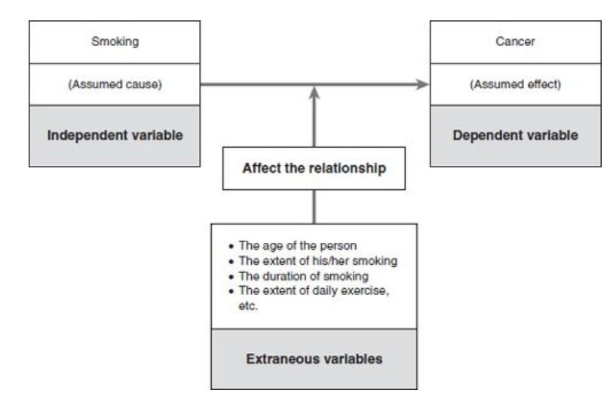
Cont.…
Independent, dependent and extraneous variables in a relationship causal

Slide 89
From the viewpoint of the unit of measurement
1. Categorical variables are measured on nominal or ordinal measurement scales, whereas for
2. Continuous variables the measurements are made on either an interval or a ratio scale.
There are three types of categorical variables:
1. constant variable – has only one category or value, for example taxi, tree and water;
2. dichotomous variable – has only two categories, as in male/female, yes/no, good/bad, head/tail, up/down and rich/poor;
3. polytomous variable – can be divided into more than two categories, for example religion (Christian, Muslim, Hindu).

Slide 90
Types of Data
data is an individual facts, statistics, or items of information.
These data represent the results of our analyses.
Data can be classified based on different attributes
Based on their Data source
Primary data: are information obtained from primary sources i.e. from the subjects of the study themselves by the researchers themselves for the first time.
Secondary data: are information gathered from secondary sources which have already been collected by someone and passed through a certain analysis by the current researchers.

Slide 91
Method of data collection
Two methods of data collection:
Primary Methods of Data Collection: Direct contact between researcher and subject of the study.
It can be obtained using the following techniques:
Observation Method,
Interview Method,
Through Questionnaire,
Experimental Method,
Secondary Methods of Data Collection:- is data collected by someone other than the researcher or Through intermediate researcher’s completed documents.
Advantages of Secondary data
It saves efforts and expenses/ economy, time.

Slide 92
Validity and Reliability of Measurement
1. Validity refers to how accurately a method measures what it is intended to measure.
If research has high validity, that means it produces results that correspond to real properties, characteristics, and variations in the physical or social world.
The notion of validity can be applied to any aspect of the research process.
2. Reliability refers to how consistently a method measures something.
If the same result can be consistently achieved by using the same methods under the same circumstances, the measurement is considered reliable.

Slide 93
Reliability vs validity: what’s the difference?
Reliability and validity are concepts used to evaluate the quality of research.
They indicate how well a method, technique or test measures something.
Reliability is about the consistency of a measure, and validity is about the accuracy of a measure.

Slide 94
Current research topics in IT
Genetically Modified Food As a Solution to World Hunger
Digital Voting Risks and Rewards
The Morality of Genetic Engineering
Technology's Effect on Fertility
The Implications of Human Identity Chips
The Pros and Cons of Human Cloning
Children's Use of Technology and Social Media
Video Gaming as a Solution to World Problems
Online Education's Effect on Learning

Slide 95
Ethics in Research
Ethics
  Moral principles of right and wrong
  Not absolute; may vary by person, by time, by place
  And may be in competition with each other
Research ethics
  Incorporating ethical principles into research practice
  May involve a balance between and within principles and practices
  All stages, all those involved, from inception of research through to completion and publication of results and beyond
Involves the application of fundamental ethical principles to planning, conducting & publishing of research

Slide 96
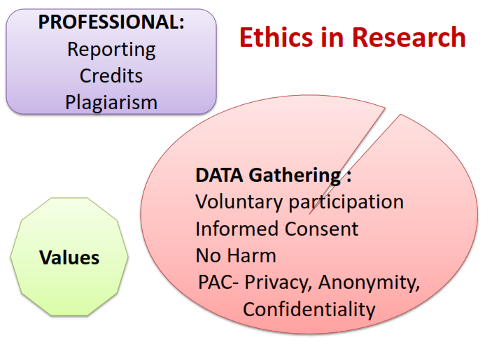
Ethics in Research

Slide 97
Ethics in Research
Ethical Principles in Research
  Voluntary Participation (Informed consent- Components, deception – procedures)
  No harm to the subjects - Non-maleficence - Do no harm (commission or omission) minimize harm
  PAC: PRIVACY, ANONYMITY AND CONFIDENTIALITY
  Beneficence - promotion of well being (maximize benefit)
  Autonomy - make own decisions
  Integrity

Slide 98
THE END!
GOOD LUCK!

